Slide 1



Ethics for Digital Projects & Research
GO TO:
http://tinyurl.com/???
use firefox as browser for workshop
Workshop leaders:
Kelsey Chatlosh
GC Digital Fellow
kchatlosh@gradcenter.cuny.edu
@kchatlosh
Patrick Sweeney
GC Digital Fellow
psweeney@gradcenter.cuny.edu
Some slides adapted from:
Mary Catherine Kinniburgh
GC Digital Fellow
mckinniburgh@gmail.com
@mckinniburgh

Slide 2
Ethics
n. Moral principles, or a system of these.
~Oxford English Dictionary Online
Digital Projects & Research
Projects or research that engages with the digital - i.e. that examines, uses or creates digital tools or platforms

Slide 3
Our Approach to Ethics
“Do the right thing”
Keep questioning
Levels of impact
1. Direct impacts on people
2. Role in knowledge production & category formation
3. Social, political or economic effects
4. Access & attribution
(We will return to this topic in more depth later…)
Source: Annette Markham, “OKCupid data release fiasco: It’s time to rethink ethics education” (2016)

Slide 4
Your Digital Work
Ethical concerns vary between people, disciplines, projects and tools.
Introduce yourself to the person next to you:
Name
Program
Current or upcoming digital research or projects?
Digital tools that you use?
Ethical concerns?

Slide 5
Workshop Goals
We will:
consider ethical practices to satisfy institutional needs (IRB) and working with “human subjects,”
create a working set of guidelines for ethical research,
explore ethical questions when doing various forms of digital research and using digital tools,
discuss the ethics of example projects and methodologies,
envision and elaborate on our own ideas and concerns!
Notes:
Make a point to have all students follow the link to the google doc - and to write their name down as a contributor (or alias or opt out) and begin sharing notes and sources there

Slide 6
Okay, ready?

Slide 7
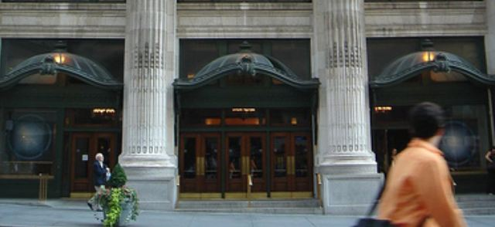
Starting with ethics from the standpoint of the institution
We’ll organize our review of guidelines around the following steps:
Institutional ethics
AND more radical ethics
THEN
Questions / case examples
Assess / Share results.
Messy categories, and we’ll discuss why.
Many debates, we will discuss too.
https://gcdi.commons.gc.cuny.edu/

Slide 8
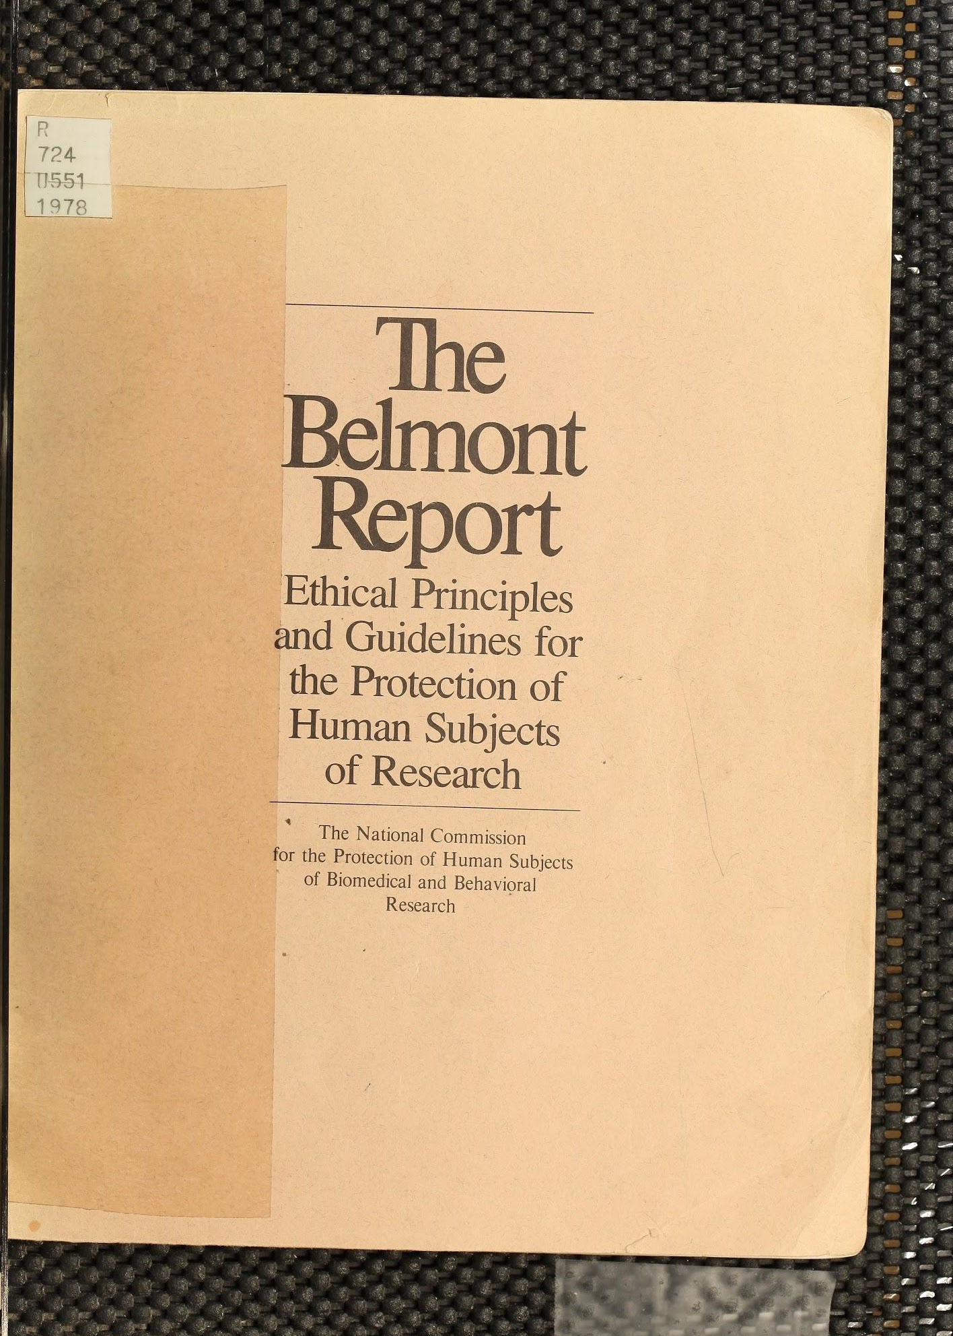
Belmont Report
National Research Act of 1974
Est. the National Commission for the Protection of Human Subjects of Biomedical and Behavioral Research
Learn more here
https://archive.org/details/belmontreporteth00unit
Notes:
Brief background:
“On July 12, 1974, the National Research Act (Pub. L. 93-348) was signed into law, there-by creating the National Commission for the Protection of Human Subjects of Biomedical and Behavioral Research... The Belmont Report attempts to summarize the basic ethical principles identified by the Commission in the course of its deliberations. It is the outgrowth of an intensive four-day period of discussions that were held in February 1976 at the Smithsonian Institution's Belmont Conference Center…”

Slide 9
Belmont Report
3 core principles:
Respect for persons
Beneficence
Justice
Learn more here
Notes:
***rewrite this in plain terms / my own words! & give some quick digital examples
3 core principles to follow when conducting research with human subjects:
Respect for persons: “Respect for persons incorporates at least two ethical convictions: first, that individuals should be treated as autonomous agents, and second, that persons with diminished autonomy are entitled to protection. The principle of respect for persons thus divides into two separate moral requirements: the requirement to acknowledge autonomy and the requirement to protect those with diminished autonomy [e.g. children or prisoners]”
Beneficence: “Persons are treated in an ethical manner not only by respecting their decisions and protecting them from harm, but also by making efforts to secure their well-being… Two general rules have been formulated as complementary expressions of beneficent actions in this sense: (1) do not harm and (2) maximize possible benefits and minimize possible harms.”
Justice: “There are several widely accepted formulations of just ways to distribute burdens and benefits… These formulations are (1) to each person an equal share, (2) to each person according to individual need, (3) to each person according to individual effort, (4) to each person according to societal contribution, and (5) to each person according to merit.”

Slide 10
Belmont Report
Key concerns when applying the 3 principles:
Informed consent
Information, not deception
Comprehension
Voluntariness & right to withdraw
Assessment of risks and benefits
The nature and scope of risks and benefits - always minimize risk of harm!
E.g. question of anonymity
The systematic assessment of risks and benefits
Selection of subjects
Source: The Belmont Report

Slide 11
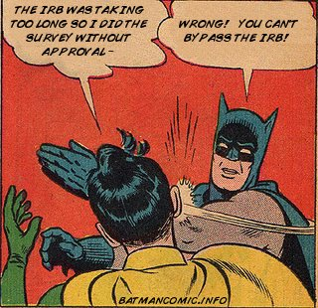
Institutional Review Board (IRB)
The CUNY Human Research Protection Program (HRPP)
“The program provides oversight, administrative support and educational training to ensure that CUNY research complies with federal and State regulations, University policy and the highest ethical standards...
The CUNY HRPP comprises of 5 University Integrated Institutional Review Boards (IRBs) and 19 on-site HRPP offices.”
http://www.southernfriedscience.com/interdisciplinarity-and-the-irb/
For more information on IRBs at the CUNY Graduate Center, click here
Notes:
Note that when we apply for IRB online through ideate (ideate.cuny.edu) you select who your advisor is - then when submit your application, it's automatically routed to that campus's IRB director

Slide 12
Pause.
Dig Deeper...
Notes:
And add notes to the google doc! Could someone jot a few notes on what we’ve covered so far from the Belmont Report & IRB?

Slide 13
More radical ethics
Levels of impact
1. “How our methods of data collection impact humans, directly”
“The distance principle”
2. “How our methods of organizing data, analytical interpretations, or findings as shared datasets are being used — or might be used — to build definitional categories… that could impact livelihoods or lives”
In other words, our role in knowledge production
3. “The social, economic, or political changes caused by one’s research”
Research in the era of the surveillance state
The labor & materials to produce tools
4. Access and attribution
Why use or produce open source tools? Or creative commons materials?
Digital accessibility for differently abled and language-speaking individuals
Big data, archives and citing your sources
Source: Annette Markham, “OKCupid data release fiasco: It’s time to rethink ethics education” (2016)
Notes:
Now to switch over to our discussion of radical ethics -
What I mean by “radical” - an approach that foregrounds the political and economic, that foregrounds the experiential and other realms that are often not taken into account or taken seriously - for today, this may mean an ethics beyond compliance, or even an activist ethics - but this is a question we can define collectively! What kind of ethics do we want to be doing?
We will look at radical ethics through the framework of “levels of impact” - the potential impacts your work may have
On point 4 I will be focusing mostly on points 1-3 today (for sake of time) - but just a few notes on access & attribution…
And specifically I want to briefly highlight Creative Commons - next slide

Slide 14
Creative Commons
https://creativecommons.org/
https://creativecommons.org/licenses/
Notes:
On point 4 I will be focusing mostly on points 1-3 today (for sake of time) - but just a few notes on access & attribution…
And specifically I want to briefly highlight

Slide 15
Key concerns for digital research
Commonly blurred definitions/boundaries:
“Human subjects”
Public vs. Private
Data(Text) vs. Persons
Learn more from the 2012 Ethical Decision-Making and Internet Research report by the the AoIR Ethics Working Committee
Notes:
What counts as a “human subject”? What humans are involved or may be effected?
How do we negotiate blurry boundaries between “public” vs. “private”? - e.g. intimate thoughts on social media that may be accessible, or credit card data
What constitutes “data” or “text” vs. “persons” - how do we define personhood?

Slide 16
The “Distance Principle”
A working definition:
“the extent to which Internet texts or data sets might connect to persons” even when “the conceptual or experiential distance between the researcher and author/participant [does not appear to be] close” (page 10)
The Distance Principle thus:
problematizes our understanding of what counts as research with ‘humans’ and therefore warrants ethical considerations
Source: Annette Markam & Elizabeth Buchanon, “Ethical Concerns in Internet Research”
Notes:
Talk to the person next to you and discuss some examples of when you might apply the “distance principle” - or “the extent to which Internet texts or data sets might connect to persons” - then we will share some as a class

Slide 17
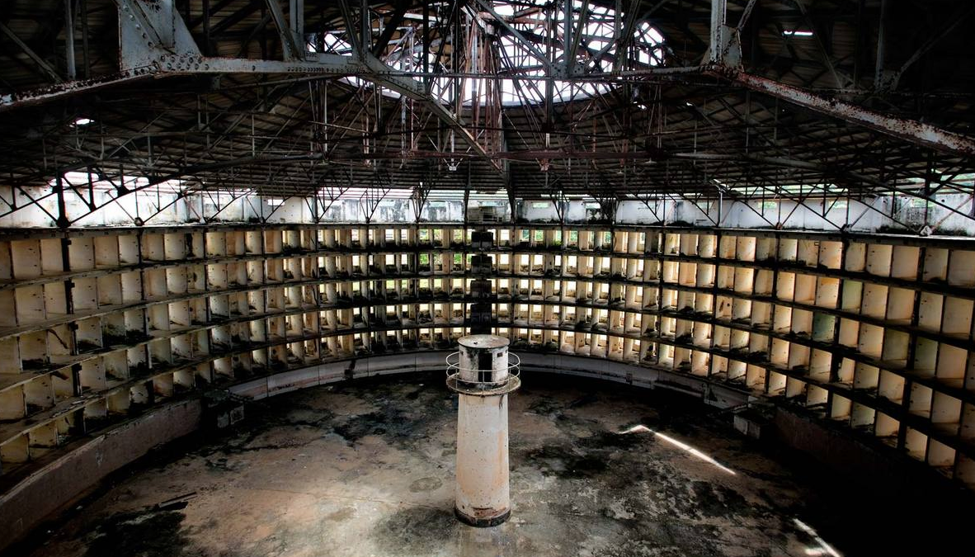
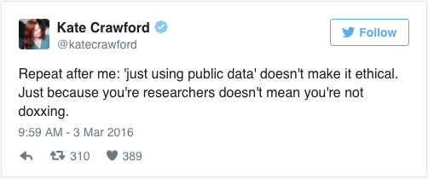
“Public” Data
“In an age of digital media, do we really have any privacy?” Is the internet itself a panopticon for the surveillance of our interactions? (Barnes)
What forms of “public” data are ethical to use? Also, how might we (inadvertently) share data?
Useful sources:
Gregory Donovan, MyDigitalFootprint.ORG
Susan Barnes, “A Privacy Paradox” (2006)
Berendt, Büchler, & Rockwell, “Is it Research or is it Spying? Thinking-Through Ethics in Big Data AI and Other Knowledge Sciences” (2015)
http://filosofiagarraf.blogspot.com/2015/06/encuentro-filosofico-abril-de-2015.html
http://annettemarkham.com/2016/05/okcupid-data-release-fiasco-its-time-to-rethink-ethics-education/
Notes:
Privacy paradox - From intimate thoughts, photos and videos being shared on social media, to government records available online, to credit card purchases accessible to market researchers - much of what we consider private is no longer that private
Anyone familiar with concept of panopticon? How might we consider the internet as a panopticon?
What forms of “public” data are ethical to use?
Awesome dissertation by Gregory Donovan - argues that: “involving youth in designing information ecologies fosters critical capacities for participating in acts of research and knowledge production. More critical participation in these ecologies, even proprietary ones, is necessary for opening opaque aspects of our environment and orienting data circulation toward more equitable and just ends.” (abstract)
Also, how might we (inadvertently) make data public? E.g. photos backed up onto servers, saving classified info to DropBox or Google Drive

Slide 18
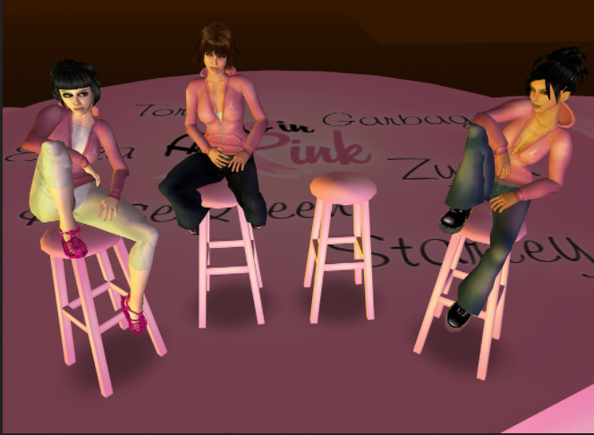
The Question of Personhood
“Is an avatar a person?”
“Is one’s digital information an extension of the self?” (AoIR)
“An Avatar Forever Voyaging 051” Flickr user Torley, 2006
Source: the 2012 Ethical Decision-Making and Internet Research report by the the AoIR Ethics Working Committee

Slide 19
Potential Areas of Concern for Digital Research
Go to this page on “Internet Research” by the USC Office for the Protection of Research Subjects,
Look through the various subheadings,
Find an example of an issue that you have encountered or think you might run into,
Discuss with your partner
Then we will share as a class
Notes:
Individual work: go to the website, look through the 11 different subheadings from “using the internet as a data source” to “cases of breach of privacy,” find an example of an issue that you have encountered or think you might run into

Slide 20
Ready for some case examples?

Slide 21
Ex. 1: USC Study on “Black Twitter”
Check out their project summary, read this brief article and discuss:
Does this project involve “human subjects”?
Are Tweets “public” data?
In reference to the article, why did this project invoke such controversy?
Notes:
Note for this section - ask participants to look through the next 4 slides and pick just 1 example to focus on (look through the website [and article if there is one] & review the questions on the slide) - then we will discuss each example as a class

Slide 22
Ex. 2: Interference Archive (IA)
Check out their website, read this brief article and discuss:
What kinds of materials does IA host and do they have rights to it?
In reference to the article, how does IA see itself as “resisting the hierarchy”?
What levels of impact does IA aim to take into account?

Slide 23
Ex. 3: Selfie City
Check out the project Selfie City, and discuss:
Does this project involve “human subjects”?
Are instagram photos “public” data?
What might be other ethical questions regarding this project?

Slide 24
Ex. 4: TBD
TBD

Slide 25
Developing Our Own Ethical Digital Research
Review the collective guidelines we have created so far and any additional notes you jotted down, and make a few notes by yourself about the questions listed on the left.
Discuss with your partner, and share with us!
{determine institutional requirements}
will you apply for IRB?
{explore more radical ethics}
what levels of impact will you consider?
{reassess your research methodology}
how will the above affect your research methods & design?

Slide 26
Additional readings & resources
Guide to Digital Data Management by the American Anthropological Association
Ricky Punzanan’s research on archives & digital access
Feminist DH
Decolonizing DH

Slide 27
Debrief.
developed our understanding of ethical practices when doing digital research
explored ethical questions when doing various forms of digital research and using digital tools
discussed alternative approaches and case examples
created a working set of guidelines for ethical digital research

Slide 28
The Lexicon of DH
Kelsey Chatlosh
GC Digital Fellow
kchatlosh@gradcenter.cuny.edu
@kchatlosh
Patrick Sweeney
GC Digital Fellow
psweeney@gradcenter.cuny.edu
Jojo Karlin
Some slides adapted from:
Mary Catherine Kinniburgh
GC Digital Fellow
mckinniburgh@gmail.com
@mckinniburgh
Survey:
http://tinyurl.com/gcdftopic
Slides:
http://tinyurl.com/lexiconofdh2016
THANK YOU!

